Slide 1
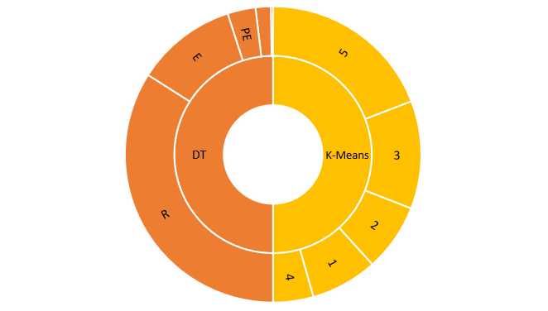
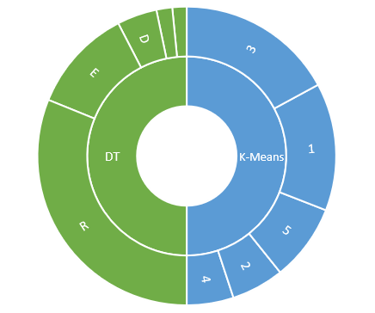
D
LM
LM
PE

Slide 2
26328
Reconnaissance:
1285
Delivery:
Decision Tree Results
2370
Privilege Escalation:
190
Lateral Movement:
Before implementing retrospective chronology
8539
Exfiltration:
5645
Cluster 1:
5715
k-means clustering results
Cluster 2:
9124
Cluster 3:
3408
Cluster 4:
14820
Cluster 5:
24101
Reconnaissance:
3345
Decision Tree Results
Delivery:
1327
Privilege Escalation:
1205
Lateral Movement:
8734
After implementing retrospective chronology
Exfiltration:
10705
Cluster 1:
4413
k-means clustering results
Cluster 2:
13232
Cluster 3:
3923
Cluster 4:
6439
Cluster 5:

